Slide 1

Chaz Bethel-Brescia, Arin Champati, Ethan Seide

Slide 2
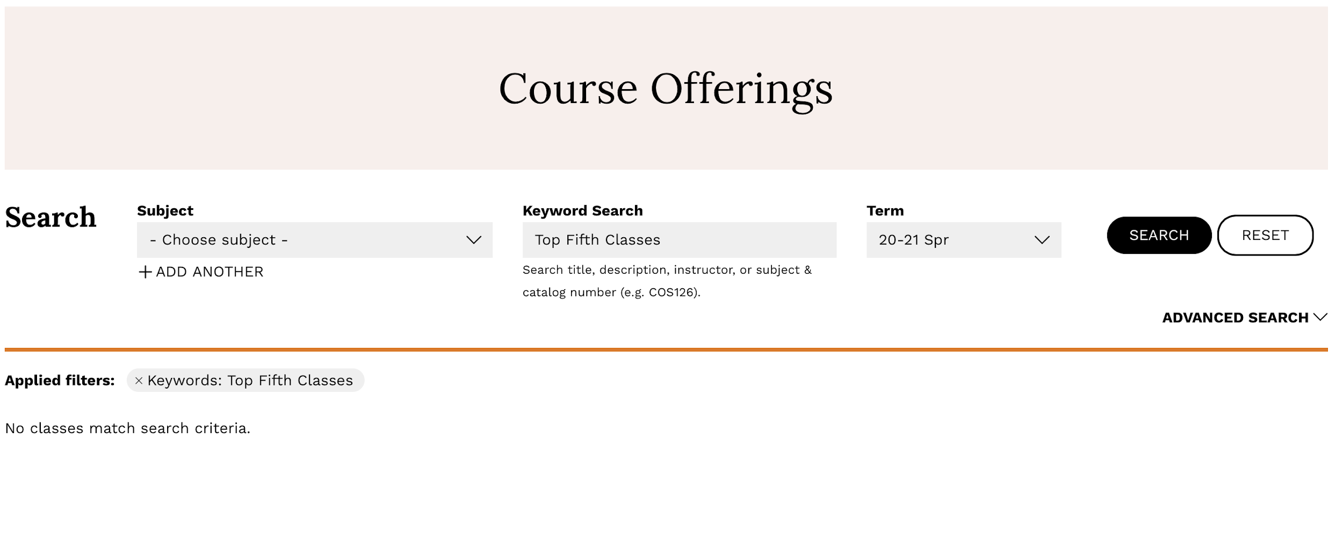
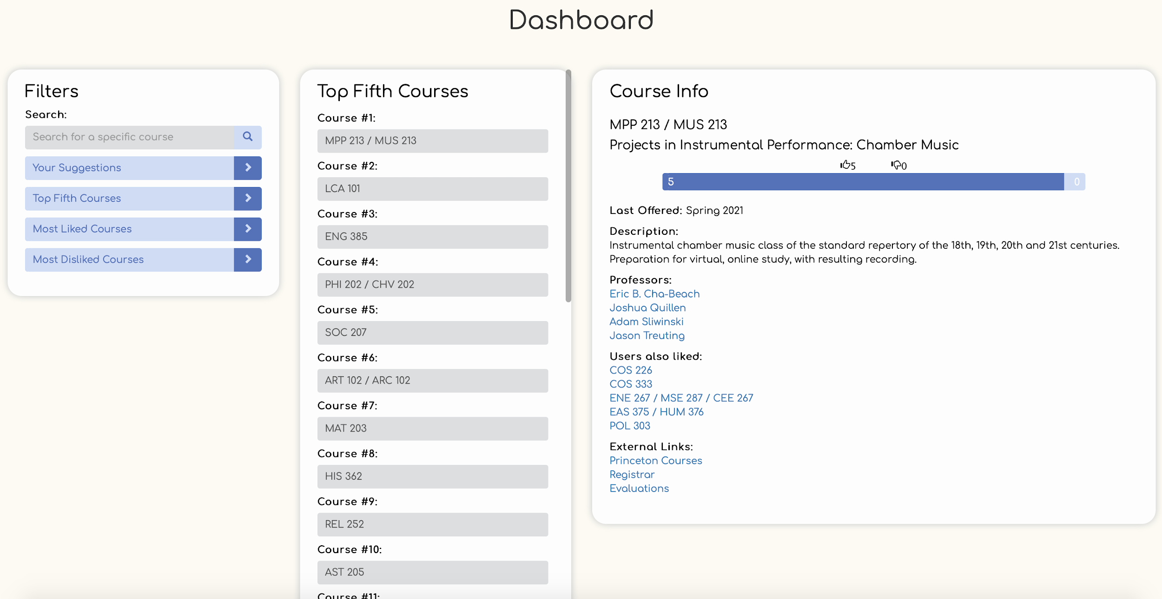
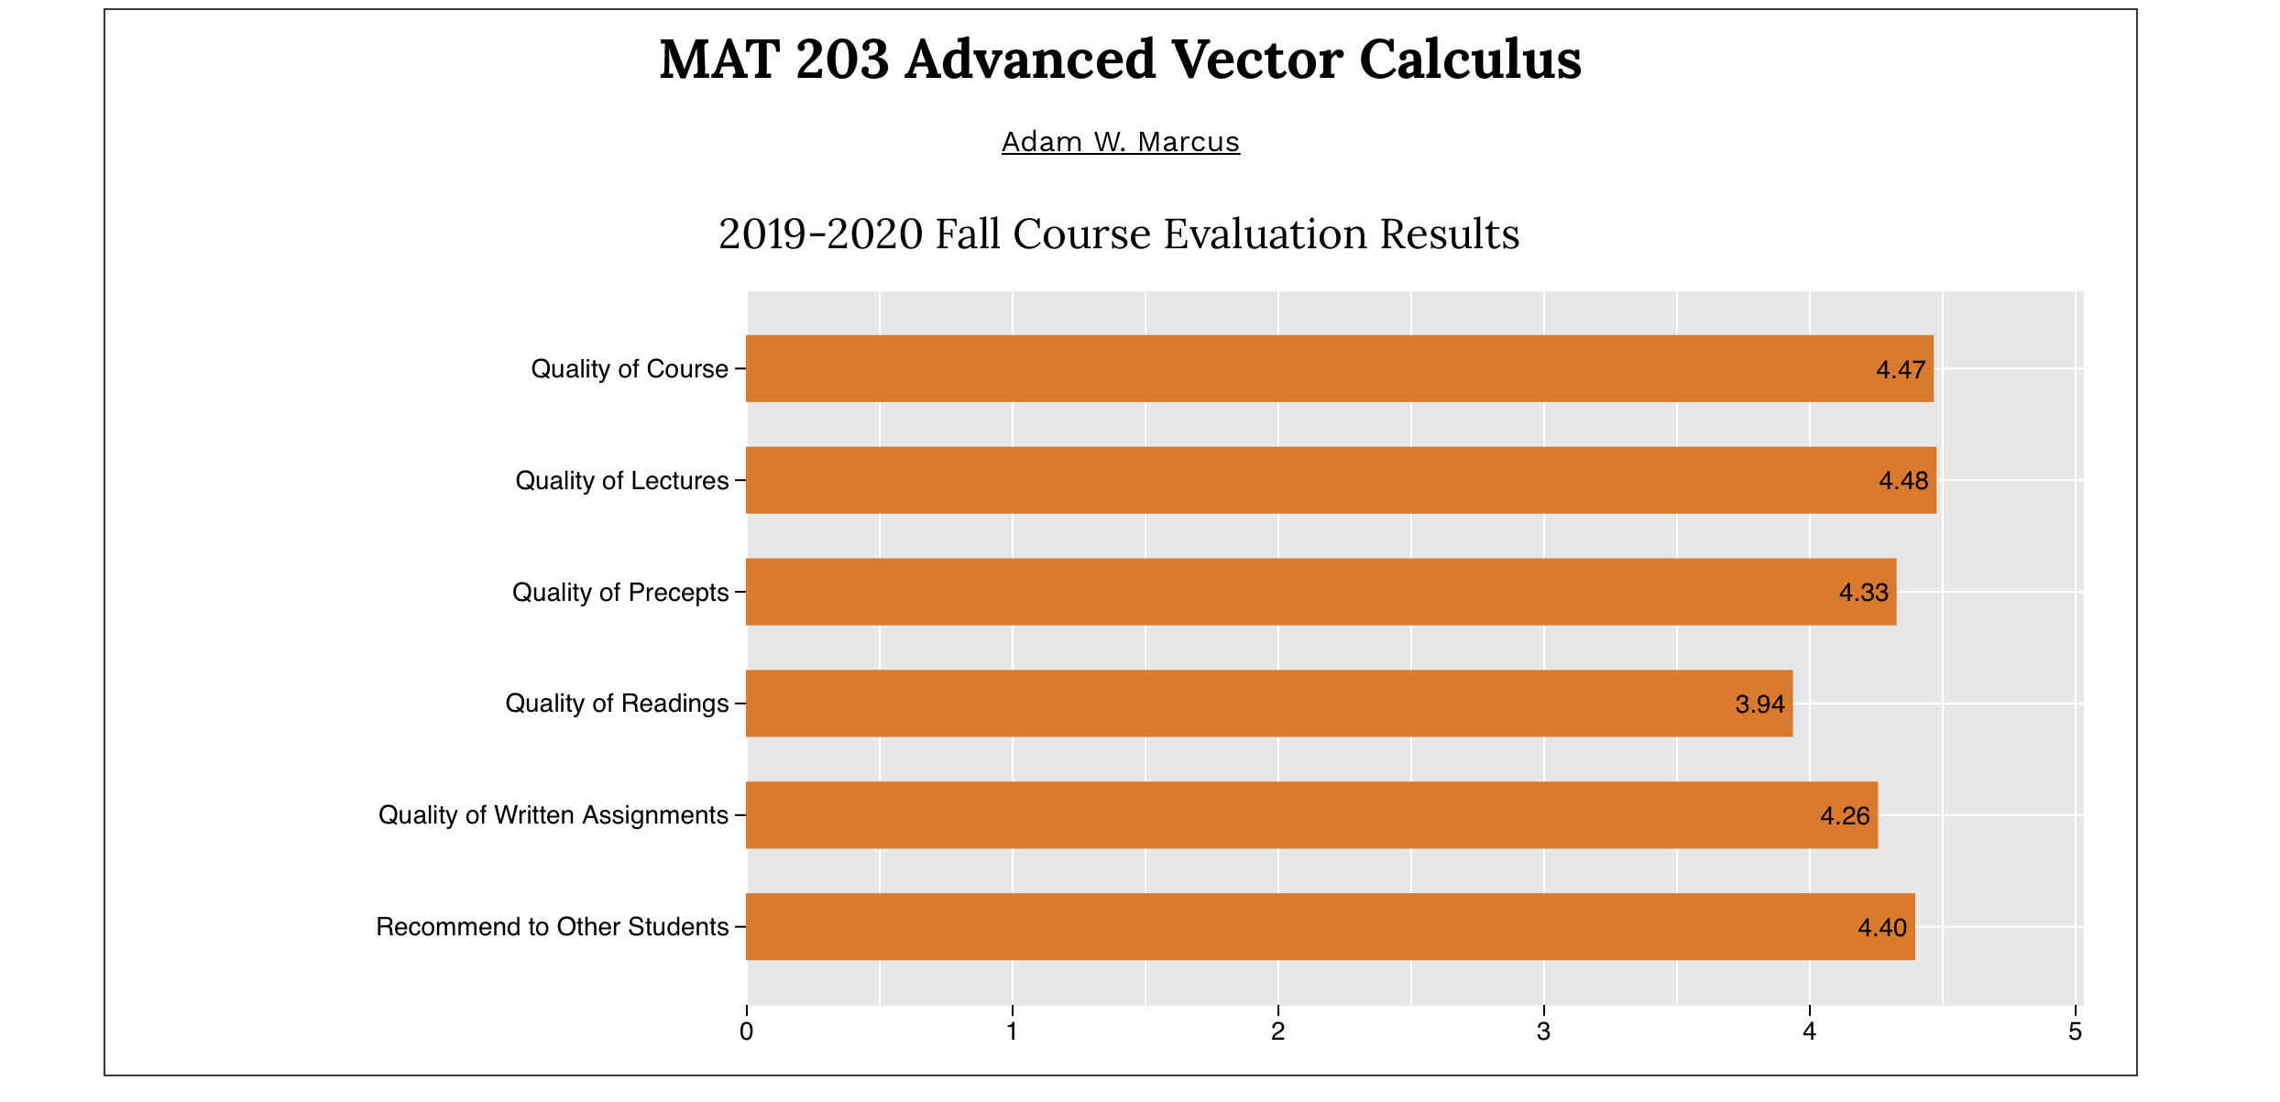
Why Class 5
Traditional Methods
Class 5
😎
pain.
Notes:
Streamlined, informed, smart suggestions
Previous methods → Registrar, sifting through reviews, asking 20 friends
Class 5 → instant course suggestions catered to your interests and preferences

Slide 3
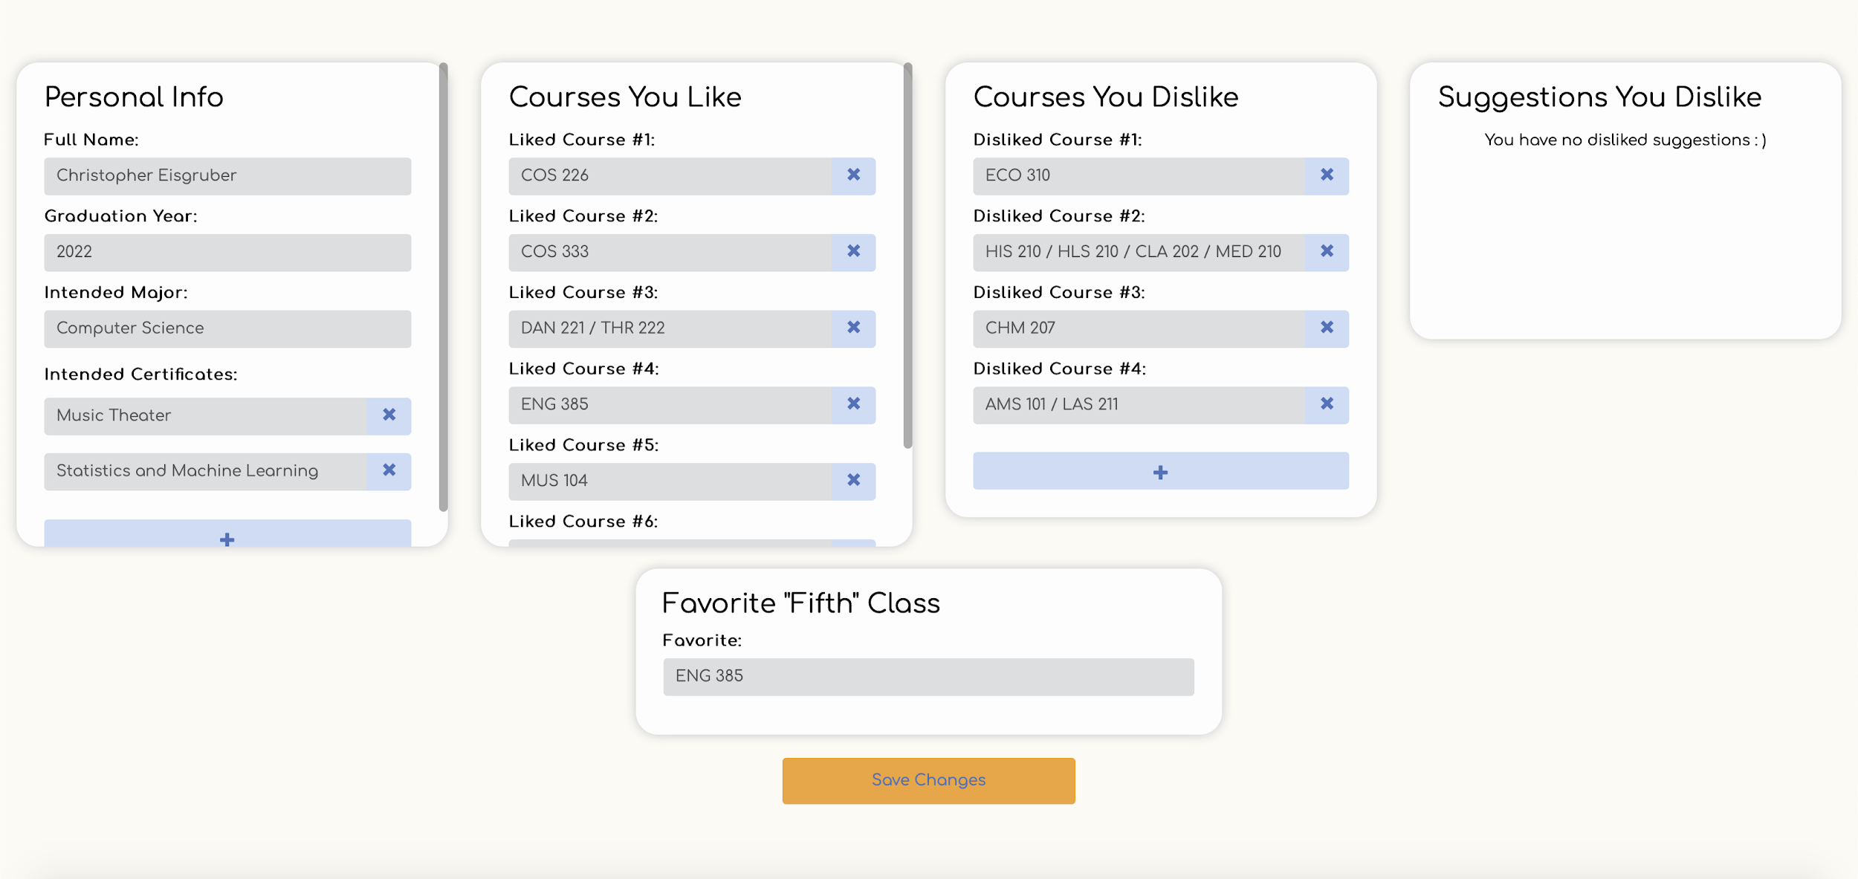
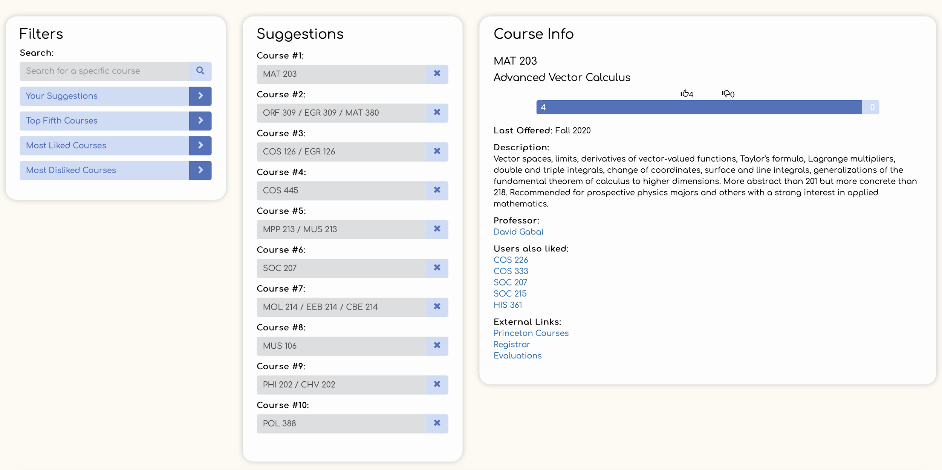
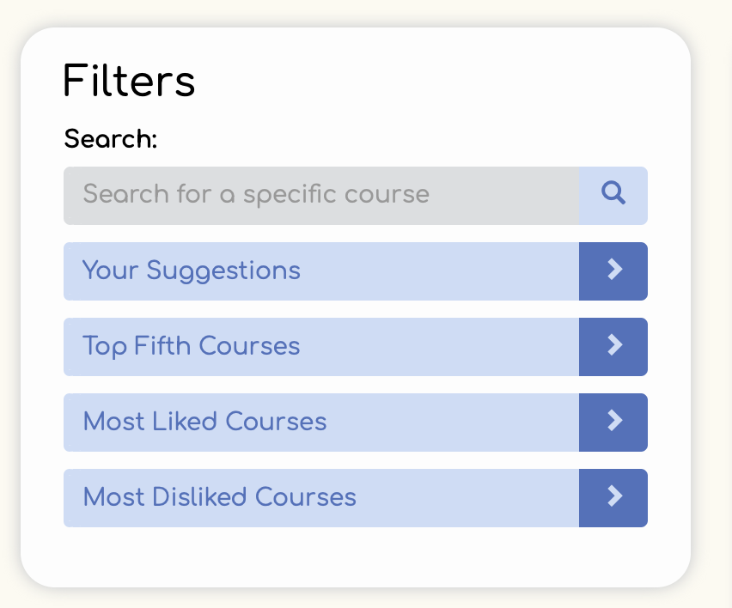
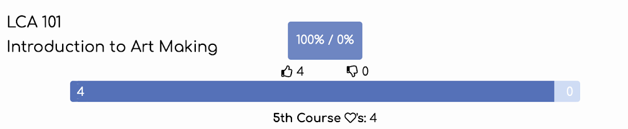
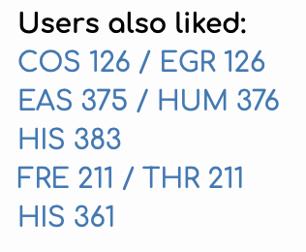
Enter Your Preferences
Get Suggestions
View Interesting Insights
Let’s take a look!

Slide 4
System Design

Slide 5








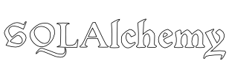


Technologies
Notes:
~30 seconds

Slide 6
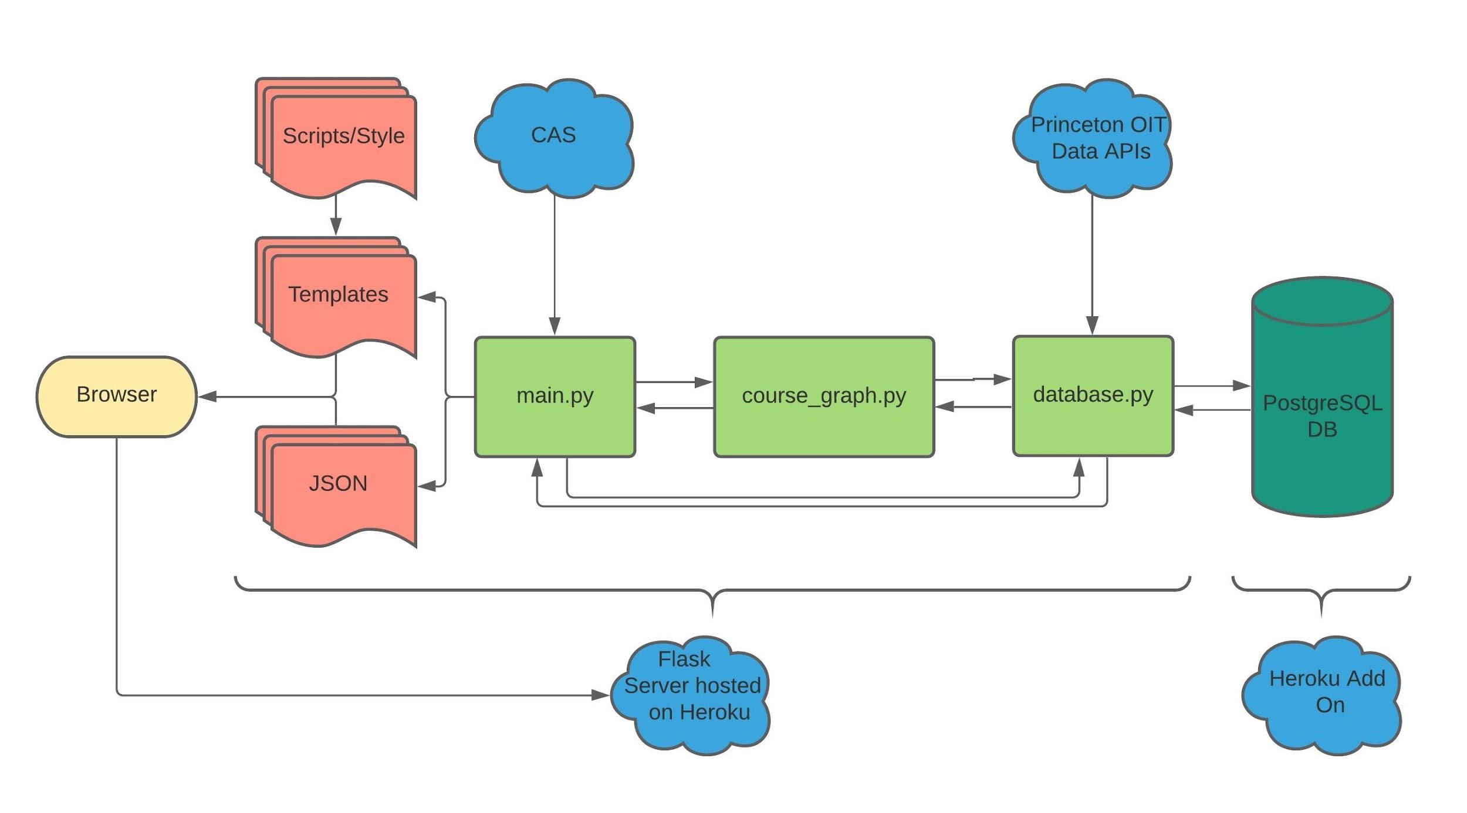
3-Tier Design
Notes:
~30 seconds

Slide 7
Dealing with Data

Slide 8
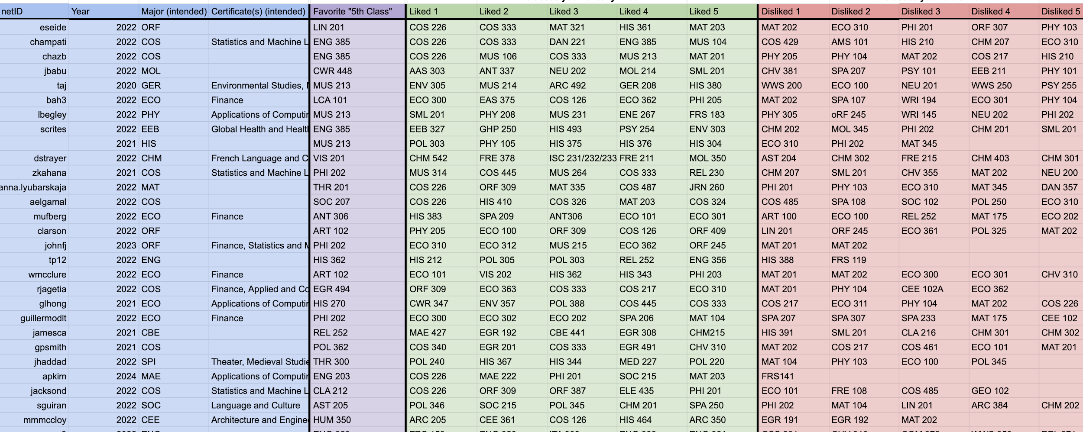
Data Sources
Princeton Data Sources
Course information (crosslistings, descriptions, professors, etc.)
User information (email address, name)
Brute Force Data
Certificates, majors
Prepopulating Database
Asked ~50 of our friends to input their data into a CSV (very STEM heavy)
Notes:
30 seconds
Crowdsourced data → but very STEM-heavy

Slide 9
Database Schema: Basic Information
Certificates
User Info
Course Info
netID
certID
order
Suggestions
Crosslistings
CourseProfs
netID
courseID
Score
rank
courseID
deptNum
order
courseID
profID
FifthClass
netID
courseID
order
Users
netID
netID
Name
classYr
major
email
courseID
Liked
netID
courseID
order
CourseDetails
DislikedSuggestions
Disliked
courseID
description
title
term
termCode
departmentName
Professors
netID
courseID
netID
courseID
order
profID
profName
Notes:
1 minute
Used relational database → third normal form
Pros
SQLAlchemy is easy to use, create + access rows with readable code
Cons
Quickly reached 10,000 row limit
~7,000 crosslistings for ~2,000 courses each take up 1 row in database → filled more of our rows
Biggest lesson learned: scope out size of data before designing a database schema

Slide 10
Course Graph

Slide 11
Database Schema: Course Graph
Benefits
Easier for us to implement
Good for demonstration of system
Problems
Updating the edges in the database is time consuming
Searching can be time consuming
Rows grow exponentially (however, capped at some limit)
If we wish to scale, we should use a graph database.
CourseEdges
courseID
courseID To
weight
courseID
UnitaryWeights
courseID
weight
numLiked
numDisliked
numFifth
Notes:
Caveat:
Used a relational database for a Graph schema
2,000 courses → already have a max of 4M edges (½ of schema)
Should have used a non-relational DB → moving forward, might switch to MongoDB

Slide 12
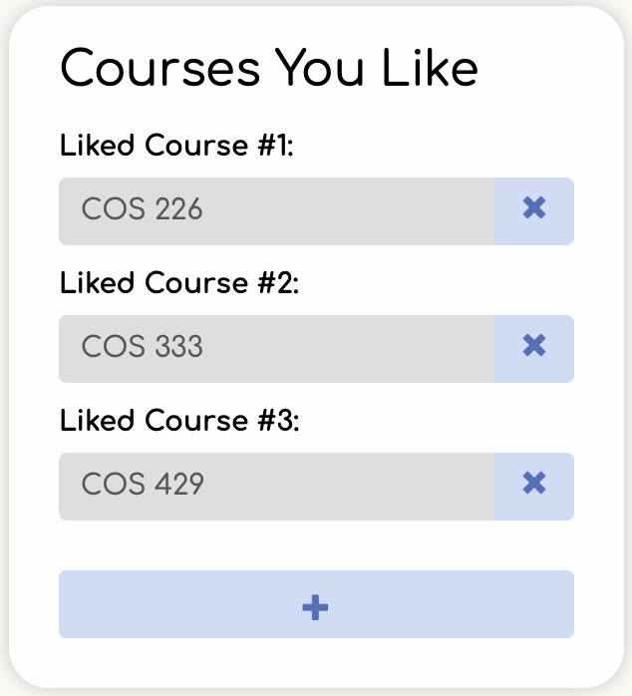
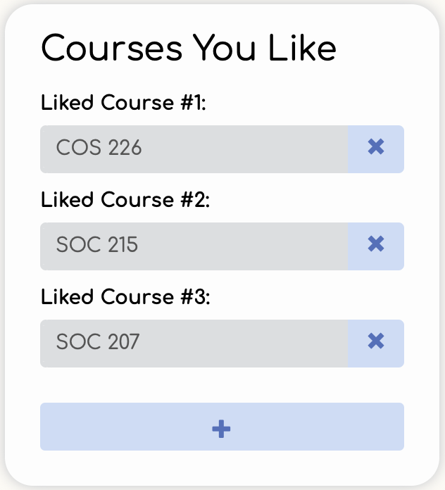
Getting Suggestions
How we get suggestions
Each course has a list of outgoing edges to mutually-liked course
Basic Example
User A likes COS 226, COS 333, COS 429
User B likes COS 226, SOC 215, SOC 207
User A is suggested SOC 215, SOC 207
User B is suggested COS 333, COS 429
User A
User B

Slide 13
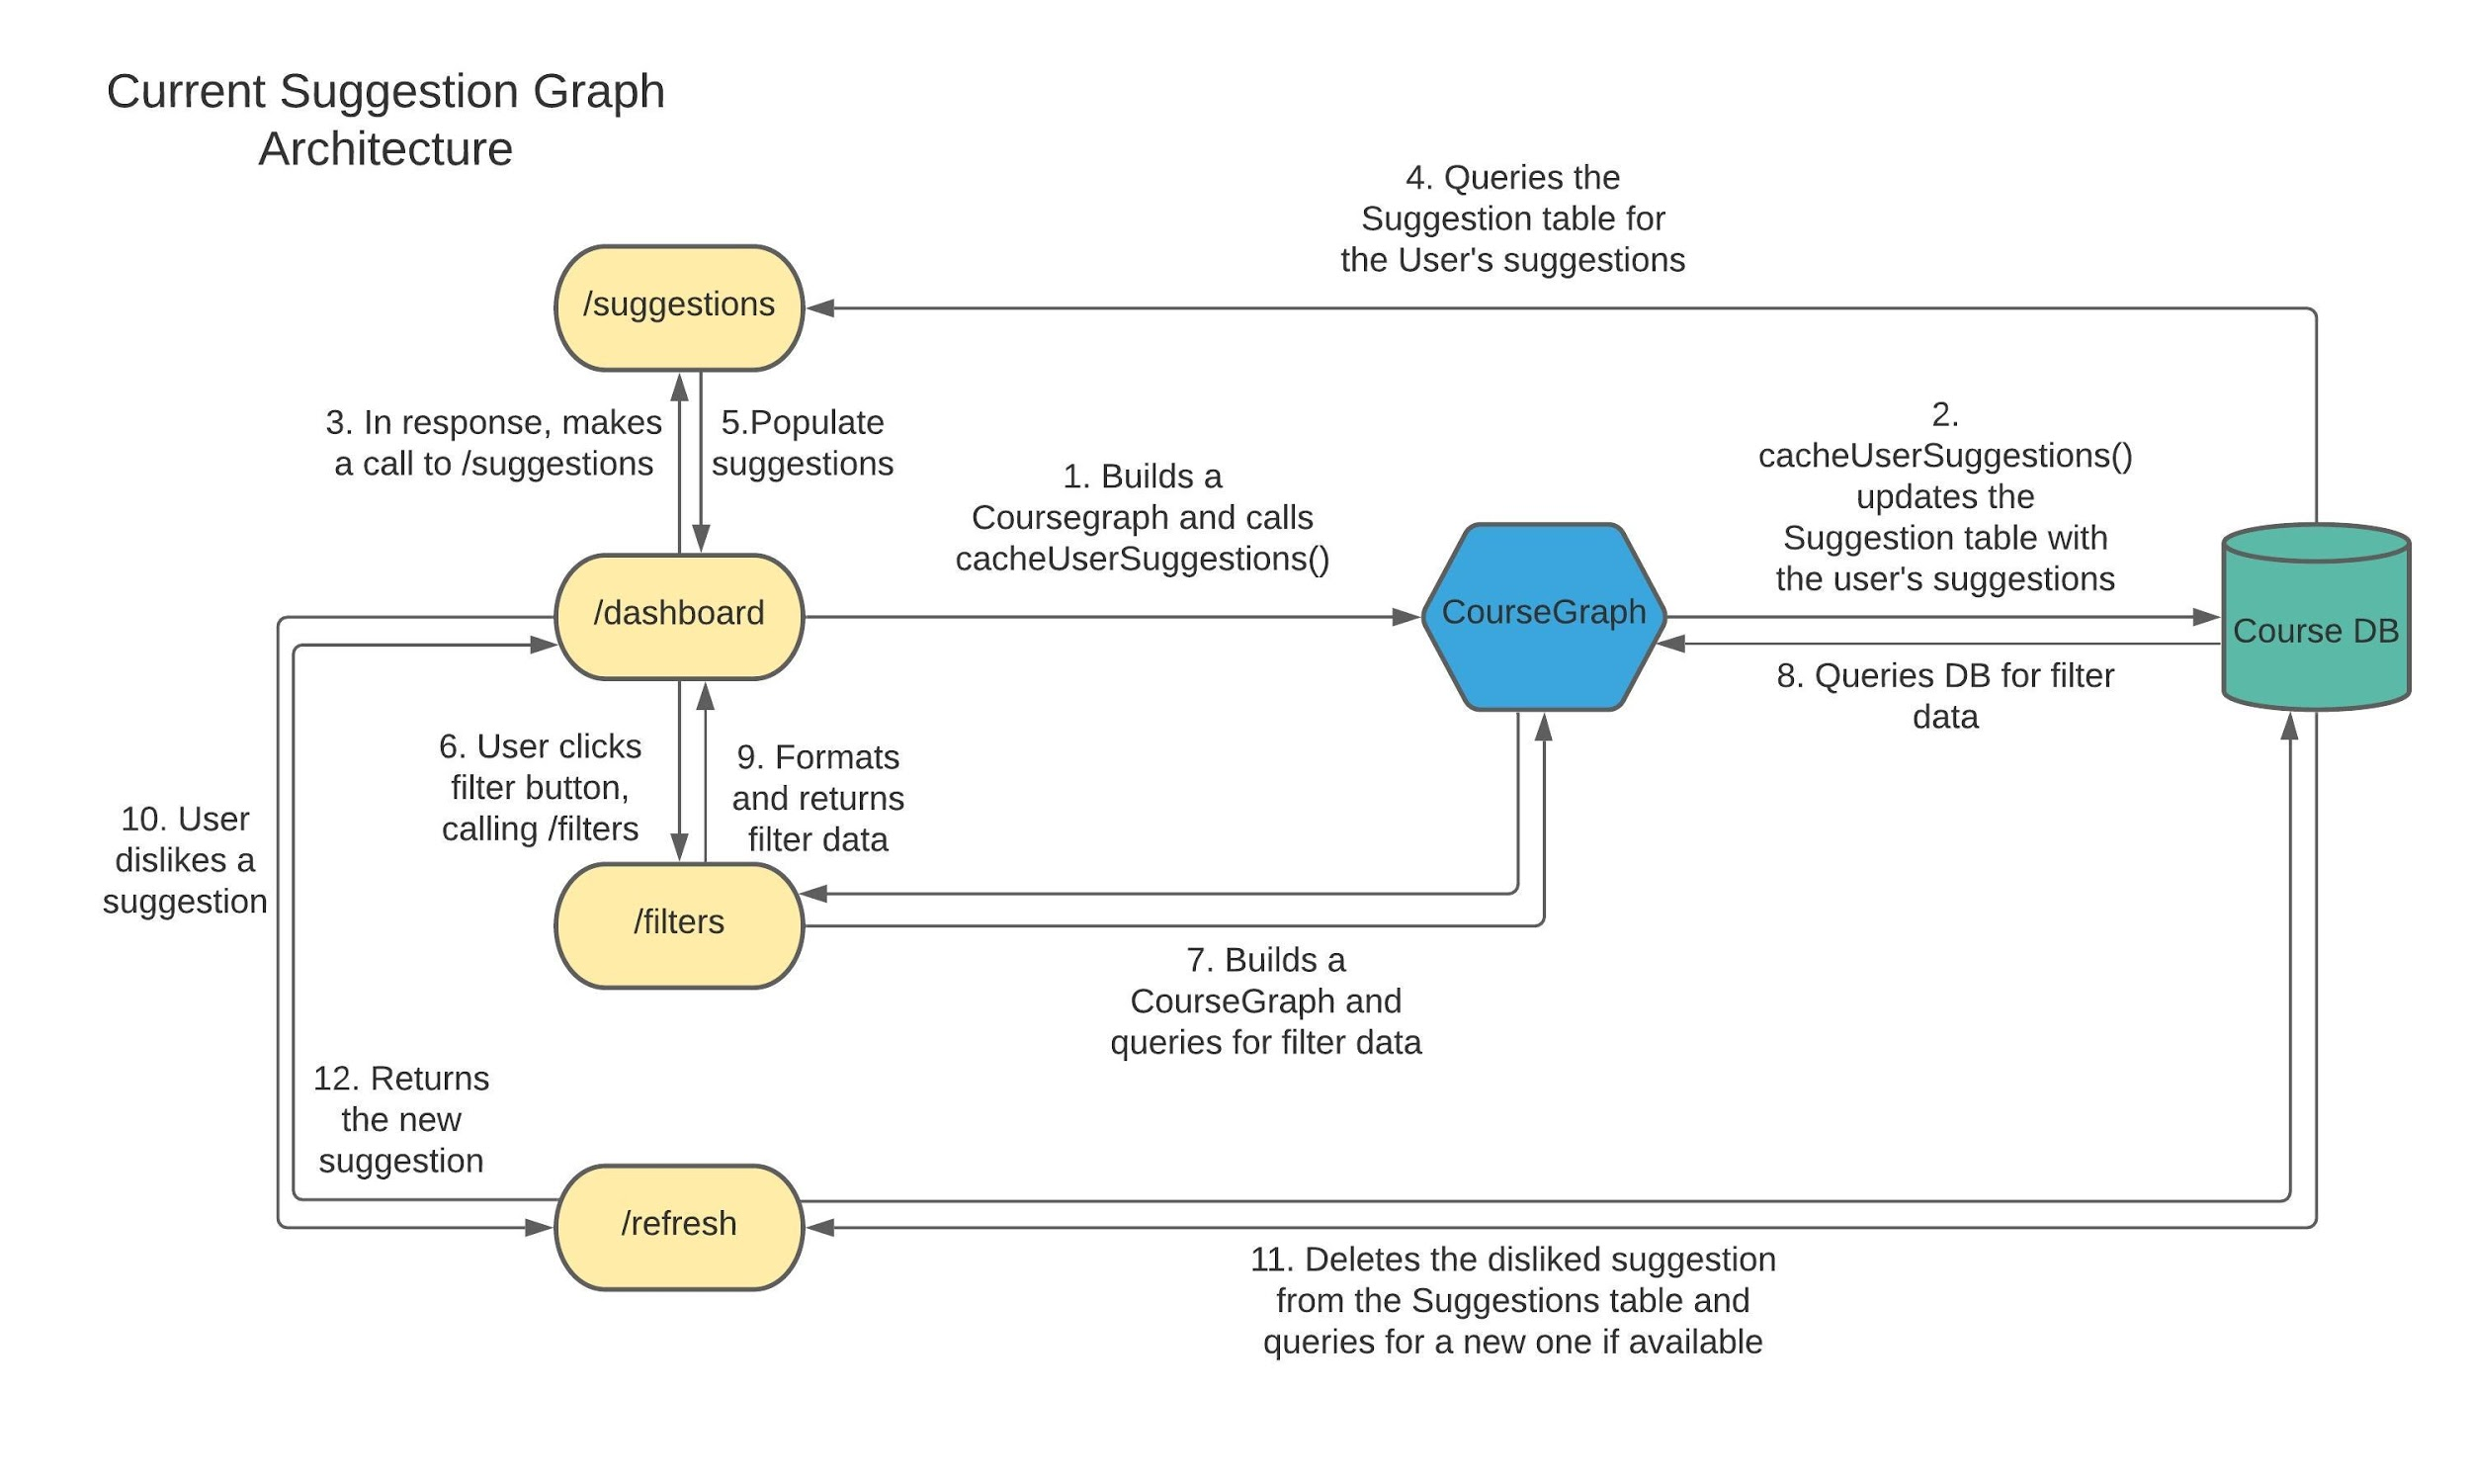
Course Graph Diagram

Slide 14
Presentation

Slide 15
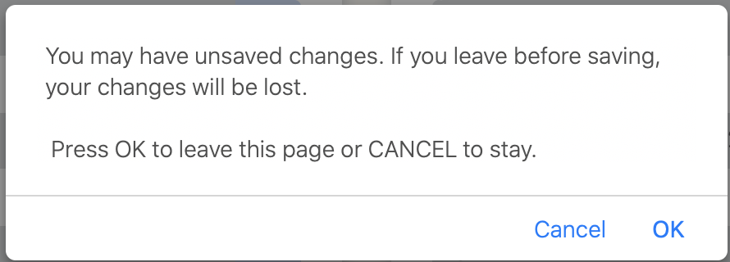
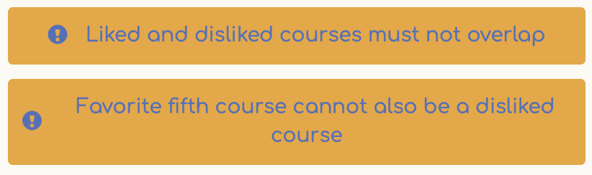
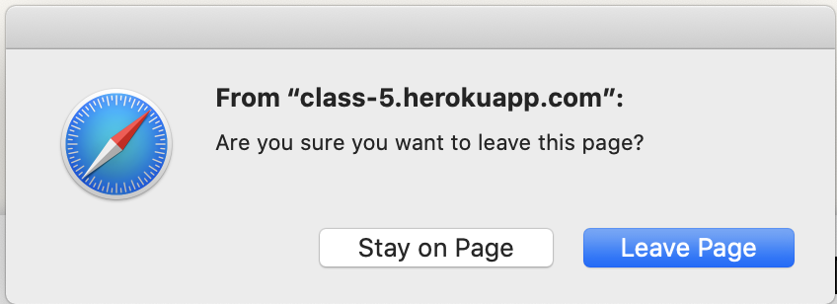
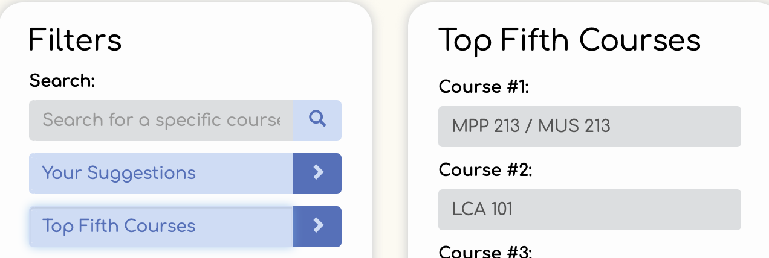
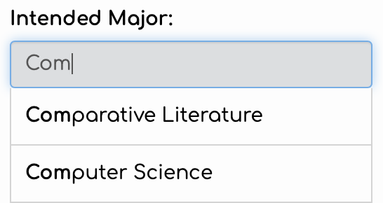
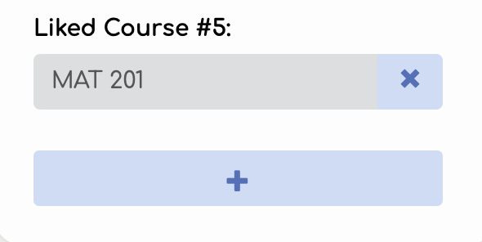
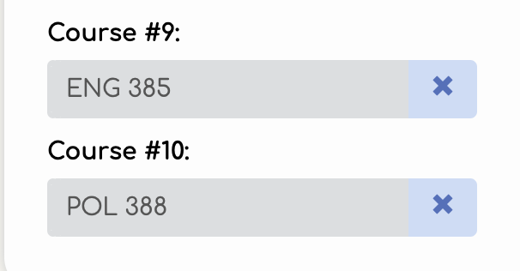
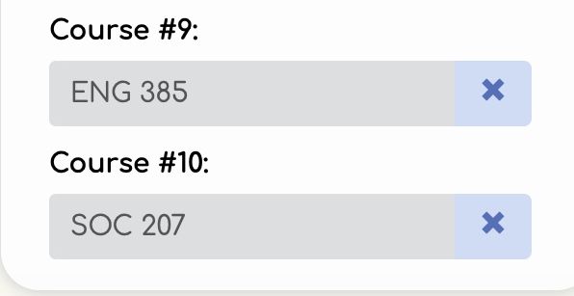
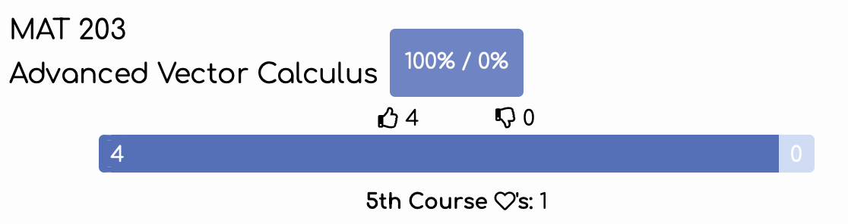
Design Elements
Autocomplete
Site-Specific Messages
Input Validation (on submit)
Responsive Filters
Autocomplete
Addable/Removable Inputs
Refreshing Suggestions
Responsive Course Information
Notes:
Front end features
Responsive design
If you have any questions → we’d be happy to answer! :)

Slide 16
Reflection
Notes:
We learned:
Scope limits of relational database before building schema
Looking forward:
Looking to build upon our app over next semester
Are actually planning to fix these problems moving in the future

Slide 17
Scaling Up
Utilize the in-memory course graph to the full extent
Perhaps switch to a graph based database
Add more features
Allow users to input course names instead of department number
Add more filters such as only suggesting courses from a certain department
Connect with TigerPath to give users more personalized suggestions
Show more course information
Improve ranking system
Combine graph with course ratings and reviews
Find better ways to weight course relationships
Notes:
~20 seconds

Slide 18
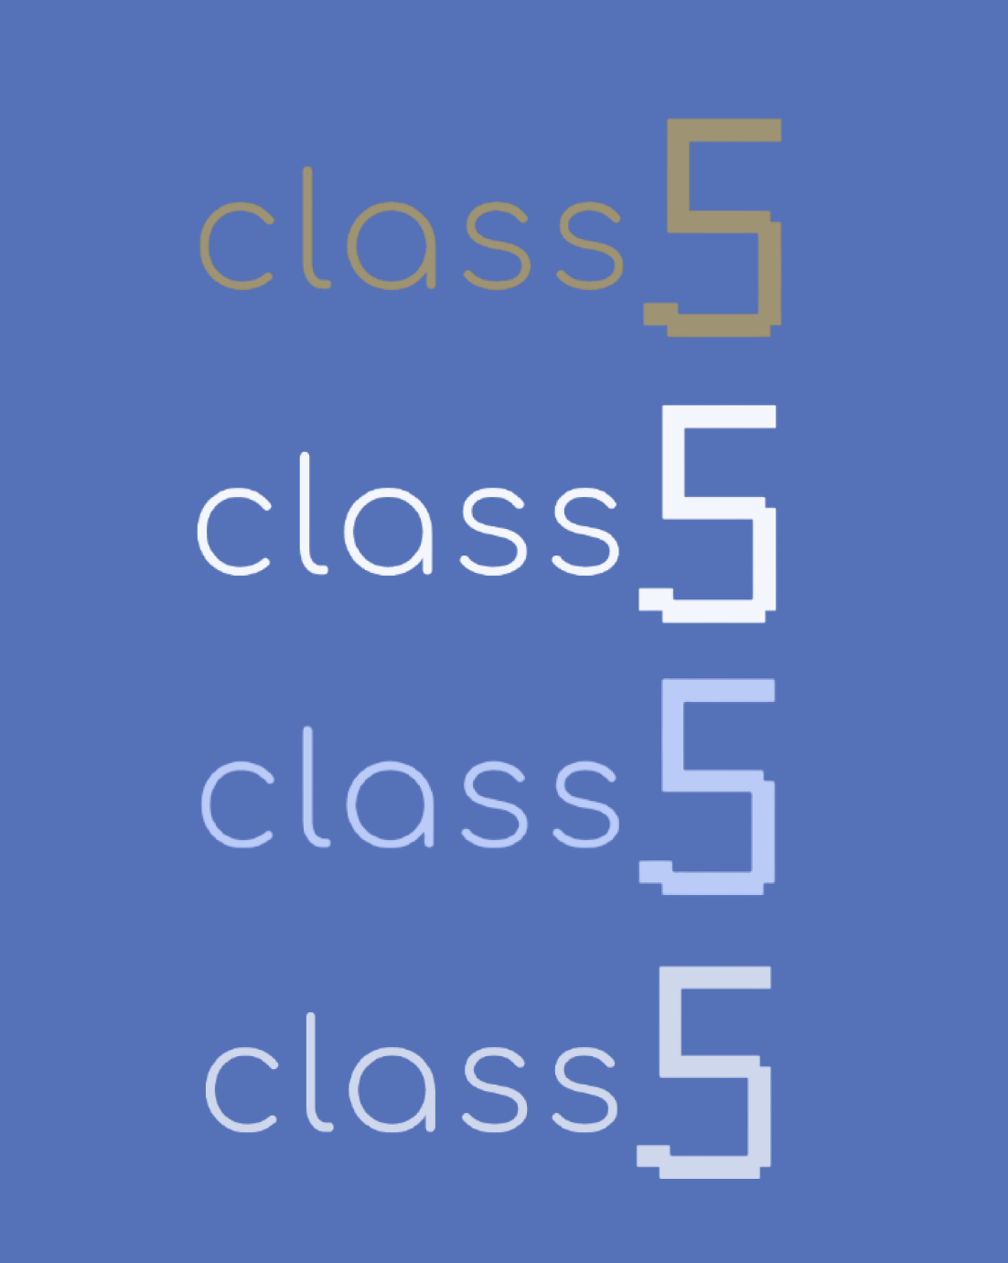
Thank you!
Notes:
Nick Turner → honest feedback + guidance along the way
Prof. Dondero → awesome piazza answers

